Slide 2


Executive Steering Committee Presentation
<Company Name>
<Project Name>
Presenter’s Name
Presenter’s Title
Organization, Division or Business Unit
Month 00, 2014
Note: The speaker notes for this slide include detailed instructions on how to customize this Title Slide with your own picture.
Tip! Remember to remove this text box.
Notes:
This is a Title Slide with Picture slide ideal for including a picture with a brief title, subtitle and presenter information.
To customize this slide with your own picture:
Right-click the slide area and choose Format Background from the pop-up menu. From the Fill menu, click Picture and texture fill. Under Insert from: click File. Locate your new picture and click Insert.

Slide 3

Agenda
Review Steering Committee Responsibilities (First Meeting Only)
Project Summary
Project Dashboard
Accomplishments this Period
Project Timeline
Project Issues and Risks
Financial Review
Change Orders
Next Period Tasks
Steering Committee Steering Decisions or Actions Needed
Notes:
This presentation could be used for a formal Steering Committee meeting for a large project, or could be tailored down to cover a Key Project Sponsor review. You will notice several options for the slides included within this template (note <Option n> in the slide titles). Choose the one that makes the most sense for your situation.

Slide 4
Steering Committee Responsibilities (First Meeting Only)
Regularly Attend Steering Committee Meetings
Identify Resources for Project and for Project Backfill
Final Authority on Scope Changes and Process Definitions
Resolve Project Conflicts and Issues
Receives Monthly Status Updates
Formal Acceptance of Project Deliverables OR Milestones
Notes:
Only Use this Slide for the First Meeting. However if the Steering Committee had action Items from the previous meeting you could reuse this slide for that purpose as well.

Slide 5
Project Summary (First Meeting Only)
Project Description - <Cut and paste data from Project Management Framework/Scope Management Plan.>
Project Scope - <Cut and paste data from Project Management Framework/Scope Management Plan.>
Notes:
Only use this Slide for the first meeting to ensure everyone understands the project.

Slide 6
Project Dashboard <Option 1: Reuse from Status Report>
Parameters | Current Status | Last Month | Comments
Scope |  |  | No concerns at this time.
Resources |  |  | Resources delayed.
Timeline |  |  | No concerns at this time.
Financials |  |  | Oracle resources needed to add additional hours.
Quality |  |  | No concerns at this time.
Risks & Issues |  |  | Two week catch-up period inserted between functional sessions. Documentation time at end of phase reduced.
Overall Status:
Notes:
Note that these are high-level topics.

Slide 7
Status Summary Dashboard <Option 2>
Key Accomplishments | STATUS – (Yellow)
Initial Set Ups - Complete CRP 1 (Vanilla System) - Complete Bus Req. Gap Analysis - Complete CRP 2 (with Initial Customizations) - Complete Primavera Interface - Complete Design and Build - In Progress | Scope - No change Schedule - Delay Mitigations In Progress Cost - No Change Project Overall – 4 Open SR’s, data cleaning / conversion and Training Material Development
Project Milestone | Target | % Complete | Status | Comments
Project Mgmt. Plan | On Schedule | 100
Bus. Reqs. | On Schedule | 100
App Setup | On Schedule | 100
DU Team Training | On Schedule | 100
CRP 1 - Vanilla | On Schedule | 100 |  | Sign off Complete
CRP 2 – Custom | On Schedule | 100 |  | Sign off Complete
Design & Build | xx/xx/xx | 50% | Y | Remediation Technical Issues: 4 open SRs – 75% Target
Primavera Interface | xx/xx/xx | 100%
Data Conversion | xx/xx/xx | 10% | Y | Mitigation In Progress –50% Target
CRP 3 | xx/xx/xx
Train the Trainer | xx/xx/xx | 15% | Y | Training Material – 35% Target
User Accept Testing | xx/xx/xx
Bus. Acceptance | xx/xx/xx
Trans. to PROD | xx/xx/xx
Project Handover | XX/XX/XX

Slide 8
Project Dashboard <Option 3: Alternate View>
Status Color
Status Month | Month YYYY
Modules | Jul 2012 | Aug 2012 | Sep 2012
PMT
BAT
Change
Financial
Technical
Risk/Issue
Budget
Good
Good
Good
Month – Year Key Accomplishments
Launched New Customer
Structured/ Engaged Project Teams
Project Charter & Admin Processes
Financial Orientation Training/ Workshops
Hardware Ordered
Good
Good
Late
Good
Good
Good
Good
Good
Start
Good
Start
(Month – year) Main Objectives
Exadata Implementation Plan
Technology Strategies/ Conversion Designs
Develop Migration Plan
Financial Conceptual Solution Design
Funded | Time | Cost | Staff
Fixed Price
Time & Mtl.
Good
Good
Good
Good
Good
Good

Slide 9
Executive Summary <Option 4>
Item | Current Status | Prior Status | Comments
Overall Project Status | Yellow | Yellow
Contracts | Green | Red | Contract signed
Scope | Green | Green
Schedule | Red | Yellow | Resource challenges
Financials | Green | Green
Project Risks / Issues | Yellow | Green
Resources | Yellow | Yellow | Productivity, availability
Notes:
These items are for a high-level status that Executives would be most interested in reviewing.

Slide 10
Accomplishments This Period
Key Deliverable/ Milestone | Owner | Est. Date | Baseline Date | Actual Date | % Complete | Status
 |  |  |  |  |  | In-Progress
 |  |  |  |  |  | In-Progress
 |  |  |  |  |  | Ahead
 |  |  |  |  |  | Complete
 |  |  |  |  |  | Ahead
 |  |  |  |  |  | Complete

Slide 11
High-Level Schedule Timeline <Option 1>
Inception | Elaboration | Construction | Transition | Production
Start: | Start: | Start: | Start: | Start:
End: | End: | End: | End: | End:
Milestone: Milestone: Milestone: | Milestone: Milestone: Milestone: | Milestone: Milestone: Milestone: | Milestone: Milestone: Milestone: | Milestone: Milestone: Milestone:
Project Event
Key Decision
Project Event
Project Event
Project Event
Go-Live!
Today
Jan-12 | Feb-12 | Mar-12 | Apr-12 | May-12 | Jun-12 | Jul-12 | Aug-12 | Sep-12 | Oct-12 | Nov-12 | Dec-12
Milestone
Milestone
Milestone
Milestone
Notes:
Provide a summary of major project activity by phase. Be certain to list upcoming activities, especially milestones, payment milestones, and go lives. If there are related issues, problems or risks, be sure to list them and discuss them later in the stakeholders meeting.
If you have multiple work-streams, list each separately and use additional slides as needed.

Slide 12
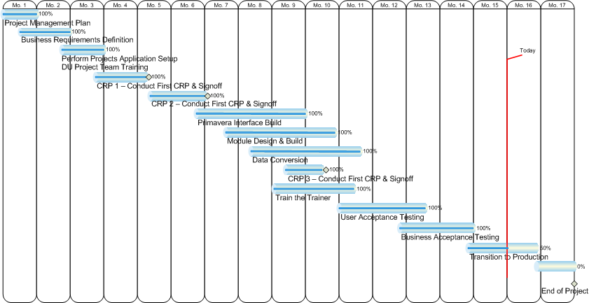
High-Level Schedule Timeline <Option 2: Using Visio>
Notes:
Please note some of the items above do not use OUM phase names or activity names (for example there is nothing in OUM called Business Acceptance Testing) However, this could still be a valid example if the enterprise implementing the system under discussion (SuD) has an existing standard for Business Acceptance Testing that is beyond what OUM describes for User Acceptance testing.
Module Design and Build (composite name) could refer to the AN and DS tasks needed to do Analysis and Design for any custom components. There is nothing in OUM called Module Design and Build.
CRP = Conference Room pilot, You won’t find the word CRP in any OUM task name, instead OUM uses the task MC.080 Conduct Configuration Prototyping Workshop. This Configuration Prototyping Workshop can be used for any Commercial Off the Shelf software configuration that needs to take place.

Slide 13
High-Level Timelines <Option 3 using PPT objects>
Q3
Q4
20xx
Q1
Q2
Jan
Feb
Mar
Apr
May
Jun
Jul
Aug
Sep
Oct
Nov
Dec
Project Start Up
Inception - Requirements gathering
Elaboration
Iteration Plan
Construction
Transition)
Cutover to Production
Production Monitor
Project
complete
Communications, Documentation, Training
12 Months
Notes:
Put in what ever high-level activities you would like to show to the Steering Committee.

Slide 14
Project Issues and Risks <Option 1>
Risk # | Description of Risk/Issue | Assigned To | Type | Expected Resolution Date | Impact on Other Risks | Date Completed | Current Status

Slide 15
Key Issues and Impact <Option 2>
# | Description | Resolution | Owner | Due | Impact/Risk | Priority
1 | Strained NRS IT / ORC Relationship | NRS to fill 2 Planned IT Positions & assess Fusion skill levels with ORC assist | Peter | 4/20/14 | Cost & Schedule | High
2 | Security Performance & Scalability | Oracle DBA Extended | Jerry | 5/5/14 | Cost | Medium
3 | CRP Delay | Rescheduled for Solution Design | Jerry | 5/19/14 | Schedule | High
4 | Business SME Assignment Delay | Fully Engaged | Chris | 4/14/14 | Schedule | Medium

Slide 16
Financial Review <Option 1>
Expenditure / PA # | Approved Budget | ATD | ETC | EAC | Status
 | $ | $ | $ | $
 |  | $ | $ | $
Planned Total Expenditure for Next Month | $

Slide 17
Financial Review (Option 2)
Project Implementation Services
Time & Material: $
Total Invoiced To-Date: $
Total Outstanding Invoices: $
Total Overdue Invoices: $
No Open Change Orders At This Time

Slide 18
Change Orders
Change Request # | Description of Change | Originator | Date Raised | Current Status | Date Approved | Date Closed

Slide 19
Next Period Tasks <Option 1>
Close out Inception <or other phase name> activities
Begin Elaboration <or other phase name> activities
Bring on team to begin Custom Development activities
Bring on team to complete Software Configuration using CRP
Xx
Xx
Xx

Slide 20
<Month> High-Level Activities and Milestones <Option 2>
 |  |  |  |  |  | 1
2 | 3 Project announcements | 4 | 5 | 6 | 7 All team members onsite | 8
9 | 10 All Team Meeting Kick-off | 11 | 12 | 13 | 14 | 15
16 | 17 | 18 | 19 | 20 | 21 BI Walk Through | 22
23 | 24 | 25 | 26 | 27 | 28 | 29 30
Applications Configuration Prototype #1 (CRP 1)
Notes:
Repeat this slide if you want to show multiple months. These slides are at a high level that the Steering Committee would find interesting.

Slide 21
Steering Committee Decisions or Actions Needed
<See slide 4 for Steering Committee Responsibilities.> (for first meeting)
For 2 – n subsequent meetings Slide 4 could be used to status the Steering Committee Decisions or Actions needed from the last Steering Committee meeting.

Slide 22
Q
&
A

